Slide 1

WSP AI GENERATED IMAGES
Engineering Tomorrow | AI-Assisted Brand Film Concept for WSP

Slide 2
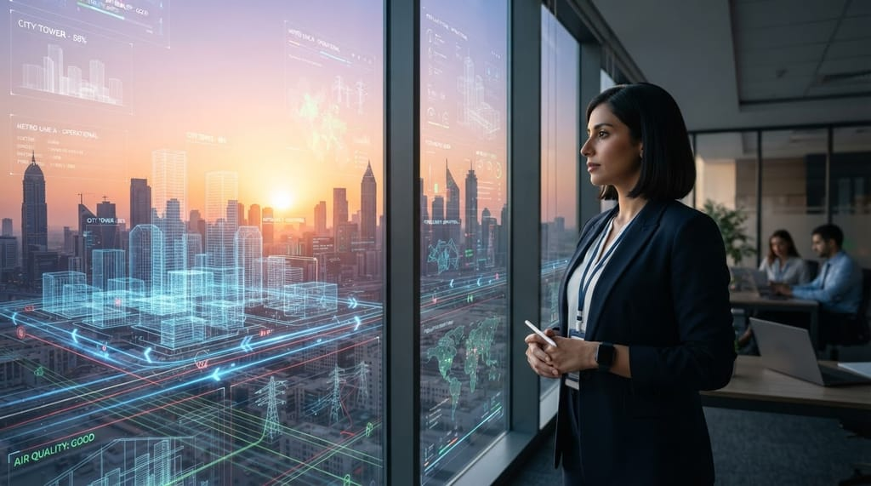
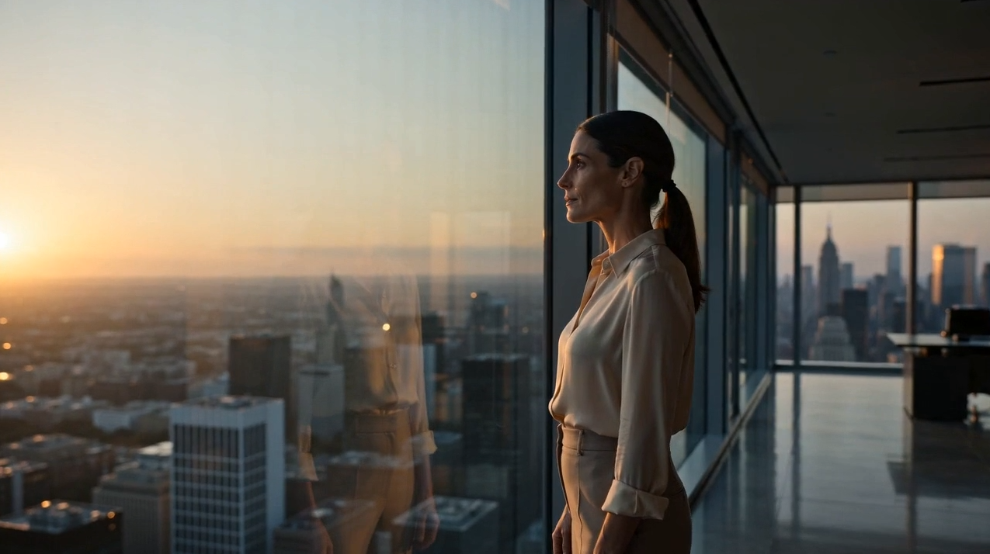
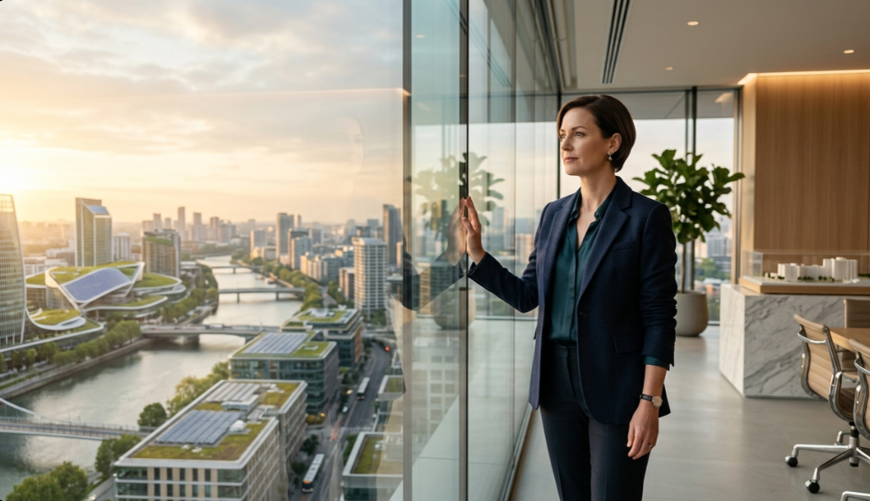
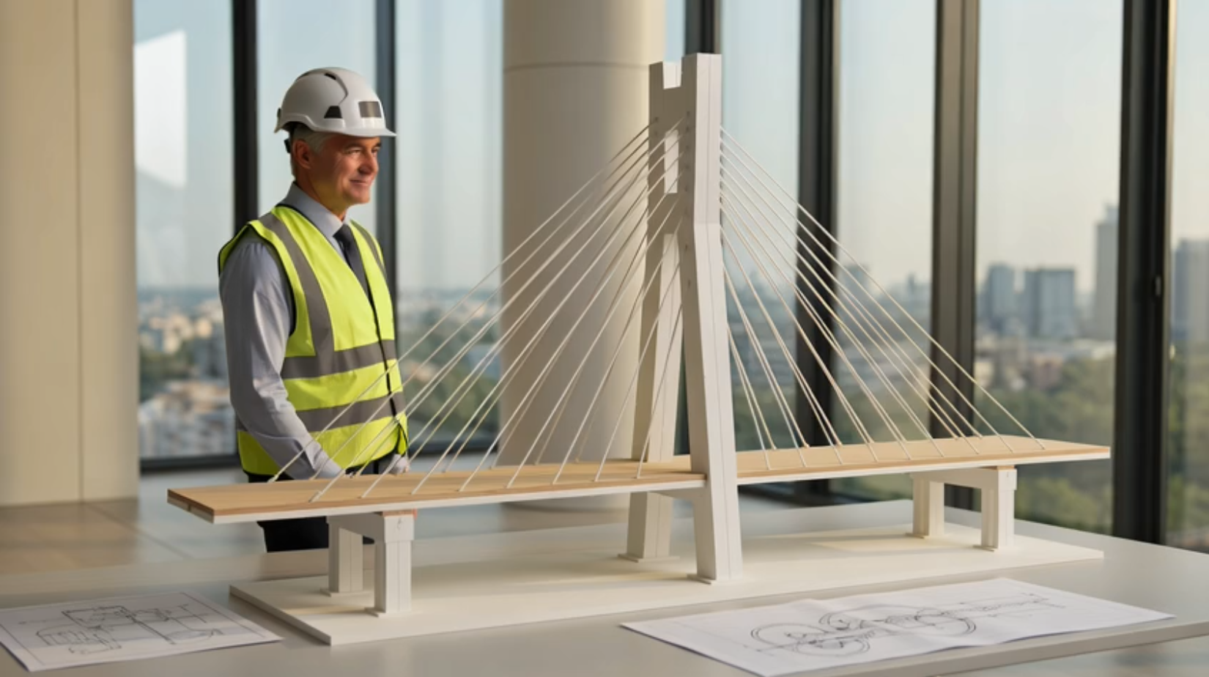
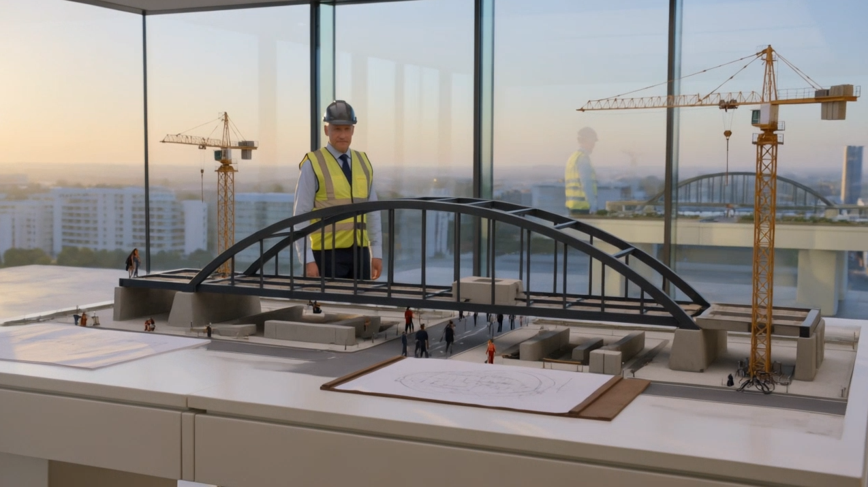
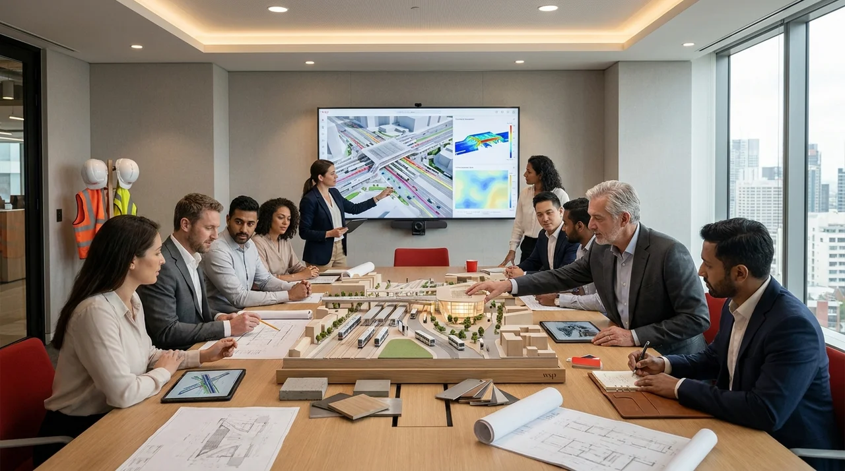
AI CREATIVE PROCESS
AI-GENERATED SUPPORTING IMAGES
"Concept images generated to explore visual direction. Selected frames were then animated and refined into motion sequences for the final film."
Concept Exploration
Concept Exploration — Final Film
Concept Exploration
Concept Exploration — Final Film
Concept Exploration
Concept Exploration
Hussein Masri

Slide 3
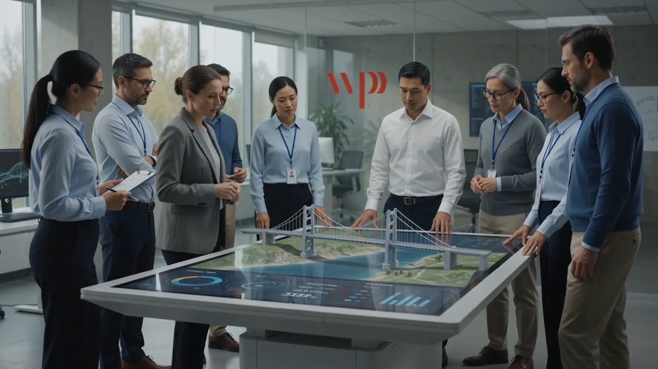

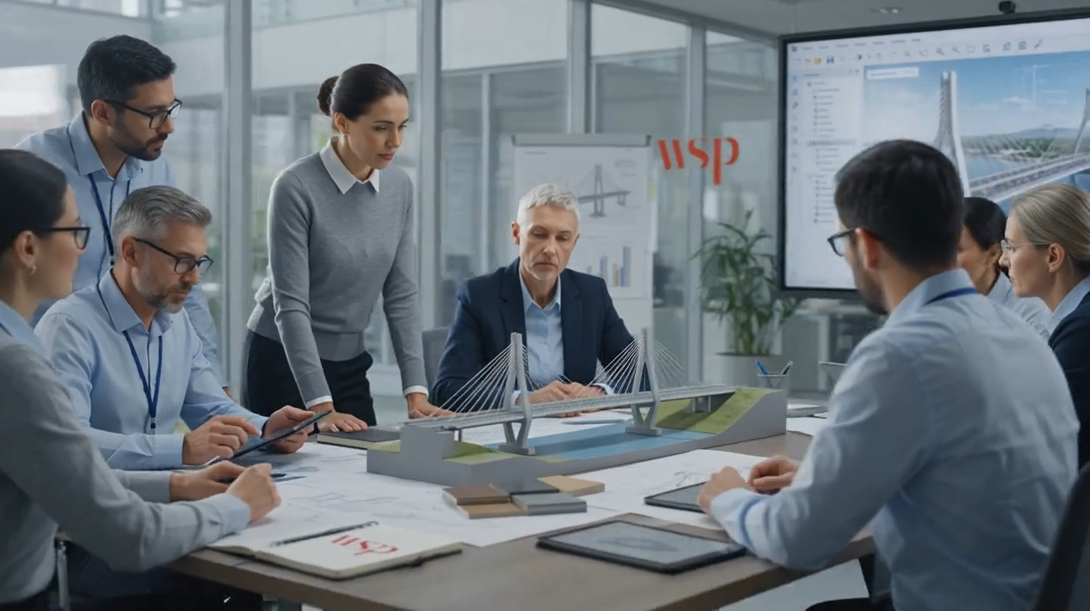
AI CREATIVE PROCESS
AI-GENERATED SUPPORTING IMAGES
"Concept images generated to explore visual direction. Selected frames were then animated and refined into motion sequences for the final film."
Concept Exploration
Concept Exploration
Concept Exploration — Final Film
Hussein Masri

Slide 4
THANK YOU

